Slide 1
ORGANIC
CHEMISTRY
MONIKA SHARMA

Slide 2
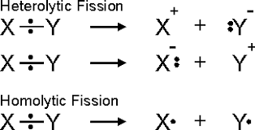
INTRODUCTION
All chemical reactions involve the breaking of existing bonds in the reactant molecules and formation of new bond in the product of molecules. Organic reactions are chemical reactions involving organic compounds.
Bond breaking in a molecule can be carried out by homolytic and hetrolytic fission.
Heterolytic fission : (Cleavage):In heterolytic cleavage, a covalent bond breaks in such a way that one fragment gets both of the shared electrons. Intermediates formed in case of heterolytic cleavage are carbanion and carbocation.
Homolytic cleavage : Homolytic cleavage a covalent bond breaks in such a way that each fragment gets one of the shared electrons. Intermediates formed in case of hemolytic cleavage is free radicals.

Slide 3
Reaction Intermediates
Intermediates are the molecules which exists in between the reactants and products.
Types of intermediates
CARBOCATIONS
CARBANIONS
FREE RADICALS

Slide 4
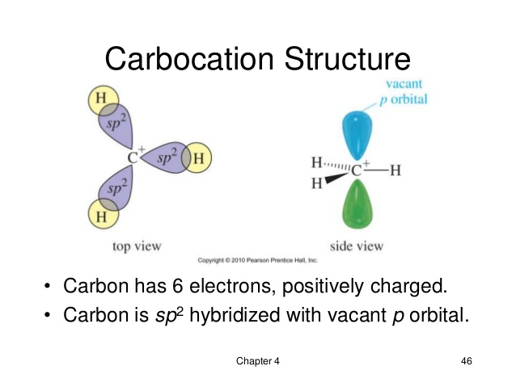
Carbocations (Carbonium ion)
Carbocations are carbon atoms in an organic molecule bearing a positive formal charge. Therefore they are carbon cations. Carbocations have only six electrons in their valence shell making them electron deficient. Thus, they are unstable electrophiles and will react very quickly with nucleophiles to form new bonds.
Carbocation Structure
Carbocation is sp² hybridized, and the vacant p-orbital lies perpendicular to the plane of three substituted groups. Therefore, it has a trigonal planar molecular structure. Carbocation requires one electron pair to complete the octet. They can react with nucleophiles, can be deprotonated from a pi-bond and can have re-arrangements in the same species

Slide 5
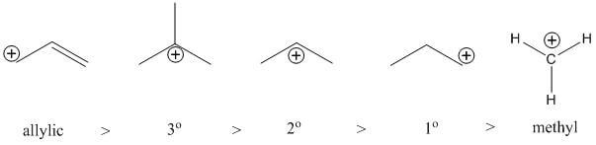
Stability order of carbocations
Carbocations prefer a greater degree of alkyl substitution. Even more so, carbocations prefer to be in the allylic position. Therefore here is the hierarchy of carbocation intermediate stability:

Slide 6
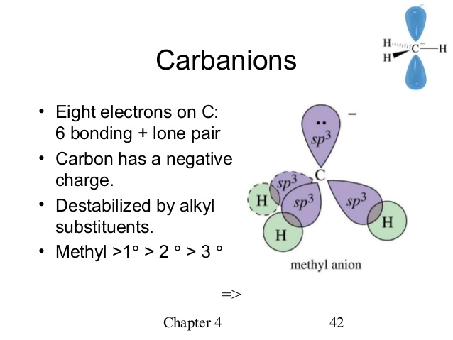
Carbanions
Carbanion are carbon atoms in an organic molecule bearing a negative charge. Therefore they are carbon anions .It is an anion in which a carbon atom possess an unshared pair of electrons with three substituents.Carbanions serve as nucleophiles in reactions. Its total number of valence electrons is equal to eight. .
Carboanion Structure
An alkyl carboanion has three bonding pairs and one lone pair; so its hybridization is sp^{3,} and the geometry is pyramidal. The geometry of allyl or benzylcarboanion is planar, and the hybridization is sp². The octet is complete in the outermost orbit of a carboanionic carbon atom and it behaves as a nucleophile to react with electrophiles.

Slide 7
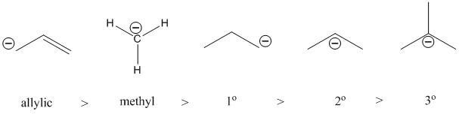
Carbanion stability
Carbanions prefer a lesser degree of alkyl substitution. Even more so, carbanions prefer to be in the allylic position. Therefore here is the hierarchy of carbanion intermediate stability:

Slide 8
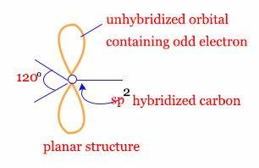
Free Radicals
Free radicals are the species which contain unpaired electrons, they may be electrically neutral. Because of their odd electrons, free radicals are usually highly reactive. They combine with one another, or with single atoms that also carry free electrons, to give ordinary molecules.
STRUCTURE OF FREE RADICAL
Structure of Free Radicals. Free radicals contain an unpaired electron. Due to this lack of a stable number of outer shell electrons, they are in a constant search to bind with another electron to stabilize themselves

Slide 9
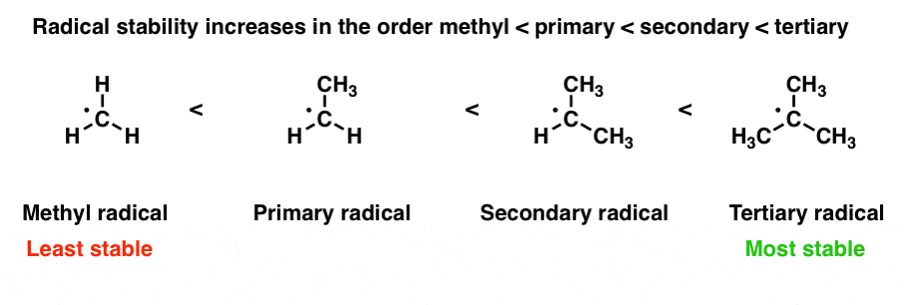
Stability order of free radicals
Stability is same as that of carbocation's

Slide 10
Attacking Reagents:
Attacking reagents are the species which attack on the reactants to give the desired product
Types of attacking reagents:
ECLECTROPHILE
NUCLEOPHILE

Slide 11
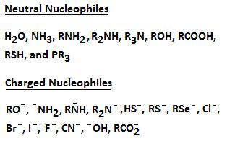
Nucleophiles
Nucleophile is a chemical species that donates an electron pair to an electrophile to form a chemical bond in a reaction. All molecules or ions with a free pair of electrons or at least one pi bond can act as nucleophiles. Because nucleophiles donate electrons, they are by definition Lewis bases. Nucleophilic describes the affinity of a nucleophile to the nuclei.

Slide 12
Electrophiles
Electrophile is an electron-deficient (Electro-Electron, Phile- Loving) Chemical species. Electrophiles are positively charged or neutral species having vacant orbitals that are attracted to an electron rich centre. It participates in a chemical reaction by accepting an electron pair in order to bond to a nucleophile. Because electrophiles accept electrons, they are Lewis acids .
Electrophiles are further divided into two categories:
1. Positive Electrophiles: H⁺, H₃O ,Cl⁺ Br^{+ ,} I^{+ ,} R⁺.
2. Neutral Electrophiles:.R, BF_{3,} AlCl3,SnCl_{4.}

Slide 13
Types of Organic Reactions
Substitution reactions :
Substitution reaction is defined as “a reaction in which the functional group of one chemical compound is substituted by another group or it is reaction which involves the replacement of one atom or an molecule of a compound with another atom or molecule. “
For example when CH₃Cl is reacted with the hydroxyl ion (OH-), it will lead to the formation of the original molecule called as methanol with that hydroxyl ion. The following reaction is as shown below-
CH₃Cl + (−OH) ———— CH₃OH (methanol) + Cl⁻
Example: Ethanol with the hydrogen iodide which forms iodoethane along with water. The reaction is as shown-
CH₃CH₂OH + HI———— CH₃CH₂I + H₂O

Slide 14
Types of Substitution Reactions:
Substitution Reactions are of two types :
Nucleophilic reactions
(ii) Electrophilic reactions.
These two types of reactions mainly differ in the kind of atom which is attached to its original molecule. In the nucleophilic reactions the atom is said to be electron-rich species(nucleophile), whereas in the electrophilic reaction, the atom is an electron-deficient species (Electrophile).

Slide 15
Nucleophilic substitution reaction
Nucleophilic substitution is a reaction in which a nucleophile selectively bonds with or attacks the positive charge on an atom. it replaces a weaker nucleophile which then becomes a leaving group; The remaining positive or partially positive atom becomes an electrophile.
The most general form for the reaction may be given as where R-LG indicates the substrate.
Nuc: + R-LG → R-Nuc + LG: LG---Leaving group
Nuc: Nucleophile R-LG…….Substrate
The electron pair (:) from the nucleophile (Nuc:) attacks the substrate (R-LG) forming a new covalent bond Nuc-R-LG. The leaving group (LG) departs with an electron pair. The principal product in this case is R-Nuc. In such reactions, the nucleophile is usually electrically neutral or negatively charged, whereas the substrate is typically neutral or positively charged.

Slide 16
Types of nucleophilic Substitution Reactions
Unimolecularnucleophilic Substitution (SN1) Reactions:
Such reactions proceed in two steps via formation of a carbocation intermediate and the product obtained is a racemic mixture
For example, the hydrolysis of tertiary halides follow SN1 pathway.
The initiation step is ionization of substrate which is slow and rate determining step.
The second step is a rapid reaction between the intermediate carbocation and the nucleophile.

Slide 17
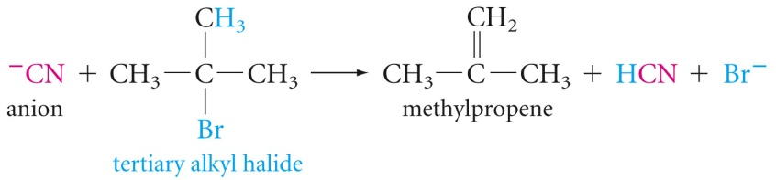

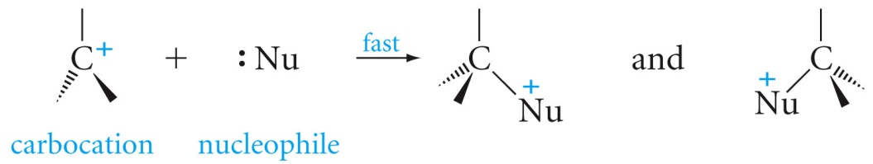
Mechanism of SN1

Slide 18
Factors influence the SN1 reaction
Effect of solvent: In SN1 reactions (or E1), the rate determining step is forming the carbocation. It doesn’t matter if the nucleophile is stabilized by a protic solvent as the carbocation attracts the nucleophile enough to still make it attack (the carbocation has a formal charge while the starting substance is a bit polar at most, in general). Thus, it doesn’t matter if the solvent is protic or aprotic (but always polar).
Effect of Leaving group: S_{N}1 reaction speeds up with a good leaving group. This is because the leaving group is involved in the rate-determining step. A good leaving group wants to leave so it breaks the C-Leaving Group bond faster. Once the bond breaks, the carbocation is formed and the faster the carbocation is formed, the faster the nucleophile can come in and the faster the reaction will be completed.

Slide 19
Effect of nucleophile:The strength of the nucleophile does not affect the reaction rate of SN1 because, as stated above, the nucleophile is not involved in the rate-determining step.
Substrate Effect: In SN1 type of reaction proceed formation of carbocation in transition state. Hence carbocation stability is more important and increases as we go from primary to secondary to tertiary, the rate of reaction for the SN1 goes from primary (slowest) << secondary < tertiary (fastest)
Stereochemistry : In SN1 reactions leads to the formation of product which is mixture of retention and inversion since the nucleophile can attack from either face of the flat carbocation.

Slide 20
Bimolecular Nucleophilic Substitution Reactions (S_{N}2 Reaction)
The S_{N}2 reaction is a nucleophilic substitution reaction where a bond is broken and another is formed simultaneously. Two reacting species are involved in the rate determining step of the reaction. The term ‘S_{N}2’ stands for – Substitution Nucleophilic Bimolecular. This reaction proceeds through a backside attack by the nucleophile on the substrate. The nucleophile approaches the given substrate at an angle of 180º to the carbon-leaving group bond. The carbon-nucleophile bond forms and carbon-leaving group bond breaks simultaneously through a transition state.Now, the leaving group is pushed out of the transition state on the opposite side of the carbon-nucleophile bond, forming the required product. It is important to note that the product is formed with an inversion of the tetrahedral geometry at the atom in the centre.
The S_{N}2 reaction mechanism for the nucleophilic substitution of chloroethane with bromine acting as the nucleophile is illustrated below.

Slide 21
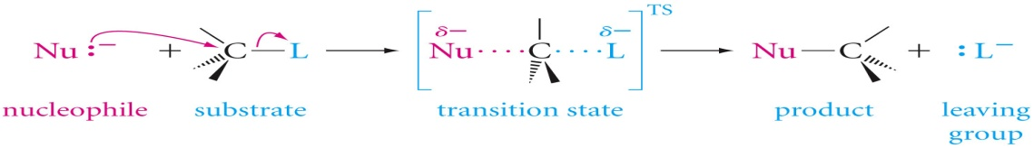
The S_{N}2 reaction mechanism for the nucleophilic substitution of chloroethane with bromine acting as the nucleophile is illustrated below.

Slide 22
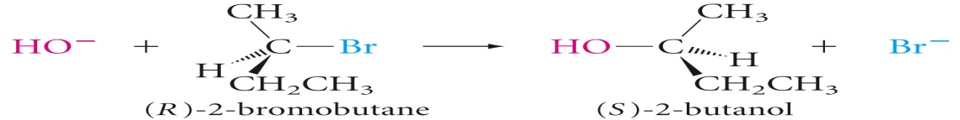
Properties of SN2 reactions
SN2 reactions are
bimolecular with simultaneous bond-making and bond-breaking steps.
SN2 reactions do not proceed via an intermediate.
SN2 reactions give inversion of stereochemistry at the reaction centre. Steric effects are particularly important in SN2 reactions.
S_{N}2 displacement reactions occure with inversion of configuration. For example, if we treat (R)-2-bromobutane with sodium hydroxide, we obtain (S)-2-butanol.

Slide 23
Factors influence the SN2 reaction
Effect of solvent :In SN2 reactions (or E2), the nucleophile needs to react with the starting substance and this is the rate determining step. If the solvent is polar then it will stabilize the nucleophile so much that it basically won’t attack. Thus non polar solvent will favor SN2 reaction.
Effect of Leaving group: The better the leaving group the faster the reaction and therefore greater reaction rate.
Effect of nucleophile : The SN2 tends to proceed with strong nucleophiles; by this, generally means negatively charged nucleophiles such as CH3O(-), CN(-), RS(-), N3(-), HO(-), and others.
Substrate Effect: SN2 reactions are mainly sensitive to steric factors, since the rate of reaction is retarded by steric hindrance (crowding) at the site of reaction. In general, the order of reactivity of alkyl halides in SN2 reactions is: methyl > 1° > 2°. The 3° alkyl halides are so crowded that they do not generally react by SN2 mechanism.

Slide 24
Stereochemistry of S_{N}2 Reactions
There are two ways in which the nucleophile can attack the stereocenter of the substrate:
A frontside attack where the nucleophile attacks from the same side where the leaving group is present, resulting in the retention of stereochemical configuration in the product.
A backside attack where the nucleophile attacks the stereocenter from the opposite side of the carbon-leaving group bond, resulting in inversion of stereochemical configuration in the product.
Since purely S_{N}2 reactions show 100% inversion in stereochemical configuration, it is clear that these Reactions occur through a backside attack.

Slide 25
Comparison of Factors affecting SN2 and SN1 reaction.
SNI | SN2
Order of reactivity: Methyl<1⁰<2⁰<3⁰, SN1 reactions have the fastest rate when the substrate can from a relatively stable Carbocations | Order of reactivity: Methyl>1⁰>2⁰>3⁰,Large groups at the reacting site will hinder the reaction, due to steric strain
Rate of SN1 is independent of concentration and strength of nucleophiles | Rate of SN2 reaction is directly proportional to the concentration of the nucleophile.
Rate of SN1 is independent of strength of nucleophile. | Strength of nucleophile, the faster the rate of SN2 reaction.
Effects of Protic Solvents: Excellent solvents for SN1 reactions - stabalizecarbocations | Effects of Protic Solvents: (water, alcohol, carboxylic acids) Decrease rates for SN2 reactions, because they solvate nucleophiles and make them less reactive relative nucleophilicities: SH->CN-~I > OH- ~ CH3O- Effects of Polar Aprotic Solvents (DMSO, DMF, DMA) Excellent for SN2 reactions - allows for maximum rates in SN2 reactions because they will not solvate anions (such as negatively charged nucleophiles), but will solvate cations (metal cations)

Slide 26
Electrophillic substitution reaction
Electrophilic substitution reactions are chemical reactions in which an electrophile displaces a functional group in a compound, which is typically, but not always, a hydrogen atom. Electrophilic aromatic substitution reactions are characteristic of aromatic compounds, and are important ways of introducing functional groups onto benzene rings.
E⁺+R-H→E-R+H⁺
Where R can be either an alkyl or an aryl group.

Slide 27
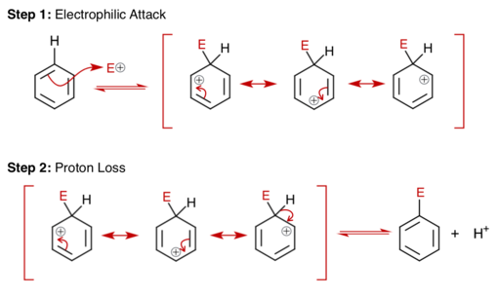
MECHANISM OF ELECTROPHILLIC SUBSTITUTION

Slide 28
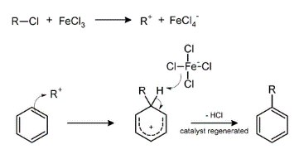
EXAMPLES
Friedel-Crafts Alkylation
It refers to the replacement of an aromatic proton with an alkyl group. This is done through an electrophilic attack on the aromatic ring with the help of a carbocation. The Friedel-Crafts alkylation reaction is a method of generating alkylbenzenes by using alkyl halides as reactants

Slide 29
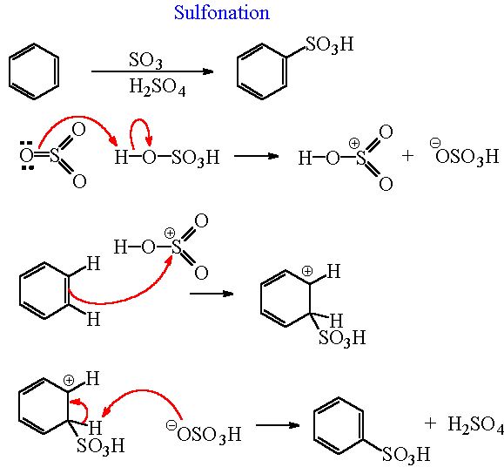
SULPHONATION

Slide 30
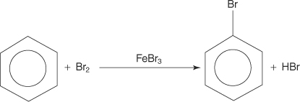
Some more electrophillic substitution reactions of benzene
Bromination of benzene

Slide 31
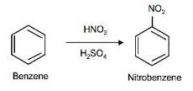
Nitration of benzene

Slide 32
ADDITION REACTIONS
In the simplest of terms of organic chemistry, we can say that an addition reaction is a chemical reaction wherein two or more reactants come together to form a larger single product. But only chemical compounds containing multiple bond character can undergo an addition reaction as a double or triple bond is usually broken to form the required single bonds. An addition reaction is essentially a reverse decomposition reaction wherein a decomposition reaction is a reaction where one compounds one or more elements or compounds. Looking at an example of an addition reaction, hydrochlorination of propane (an alkene), for which the equation is
CH₃CH = CH₂ + HCl → CH₃C⁺HCH₃ + Cl⁻ → CH₃CHClCH₃

Slide 33
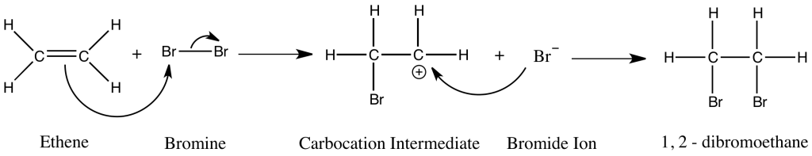
Types of Addition Reactions:
For polar addition reactions there are two classifications, namely:
Electrophilic Addition reactions
Nucleophilic Addition reactions
Electrophilic addition:
An electrophilic addition reaction can be described as an addition reaction in which a reactant with multiple bonds as in a double or triple bond undergoes has its π bond broken and two new σ bonds are formed.

Slide 34
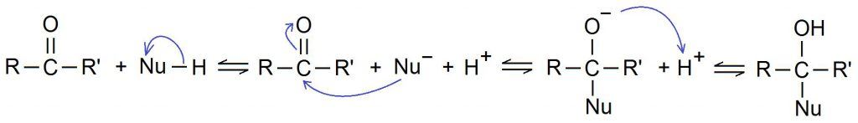
Nucleophilic addition:
A nucleophilic addition reaction is an addition reaction where a chemical compound with an electron-deficient or electrophilic double or triple bond, a π bond, reacts with a nucleophile which is an electron-rich reactant with the disappearance of the double bond and creation of two new single, or σ, bonds.

Slide 35

Rule that governs Addition Reaction is:
Markovnikovs rule:
When an unsymmetrical alkene reacts with a hydrogen halide to give an alkyl halide, the hydrogen adds to the carbon of the alkene that has the greater number of hydrogen substituents, and the halogen to the carbon of the alkene with the fewer number of hydrogen substituents".

Slide 36

Another example is hydration of alkene :
The addition of water to an alkene in the presence of a catalytic amount of strong acid leads to the formation of alcohols (hydroxy‐alkanes).
This reaction proceeds via a standard carbocation mechanism and follows the Markovnikov rule.

Slide 37


The mechanism for the addition of water to ethene follows.
The hydrogen ion is attracted to the π bond, which breaks to form a σ bond with one of the double‐bonded carbons. The second carbon of the original double‐bonded carbons becomes a carbocation.
An acid‐base reaction occurs between the water molecule and the carbocation, forming an oxonium ion.

Slide 38

The oxonium ion stabilizes by losing a hydrogen ion, with the resulting formation of an alcohol.

Slide 39
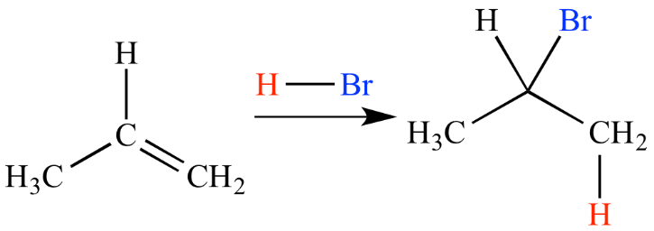
Anti-Markovnikov rule(Peroxide effect)
Anti-Markovnikov addition
It is an addition reaction between an electrophile compound HX and either an alkene or alkyne in the presence of peroxide where the hydrogen atom of HX bonds to the carbon atom with the least number of hydrogen atoms in the initial alkene double bond or alkyne triple bond and the X bonds to the other carbon atom.
Peroxide

Slide 40
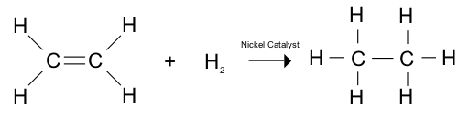
Reduction Reactions
Reduction Reactions are those which occur by addition of hydrogen
Hydrogenation
Alkenes can be fully hydrogenated into alkanes with the help of a nickel as catalyst

Slide 41

Rosenmund’s reduction.
Reduction of acyl chlorides to form aldehydes in presence of Pd and BaSO₄ is known as Rosenmund’s reduction.

Slide 42
Oxidation Reactions:
Oxidation occurs when the oxidation state of a molecule, atom or ion is increased. An oxidation will result in a net decrease in the number of C-H bonds, or a net increase in the number of C-O bonds (or equivalent).
An oxidizing agent is a substance which causes another substance to oxidize.
Oxidations reactions proceeds with addition of oxygen
Potassium permanganate (KMnO₄) is another very powerful oxidizing agent that will oxidize primary alcohols and aldehydes to carboxylic acids.

Slide 43
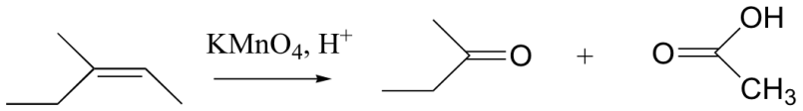
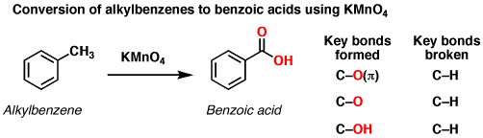
KMnO₄ is also useful for oxidative cleavage of alkenes to ketones and carboxylic acids:
Treatment of an alkylbenzene with potassium permanganate results in oxidation to give the benzoic acid.

Slide 44
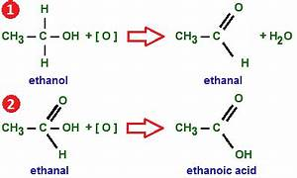
More examples of oxidation

Slide 45
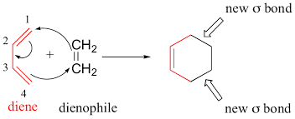
Cyclization Reactions
The types of organic reactions in which ring opening and ring closure take place
Dields Alder Reaction(Ring closure)
Cycloaddition reactions are chemical reactions that always produce a cyclic compound as the product. Most common example is Diels-Alder reaction in which diene (an organic compound with two double bonds) is reacted with a dienophile (means a lover of dienes) to produce a six membered carbon ring. Two carbon-carbon bonds are formed simultaneously in this reaction.

Slide 46
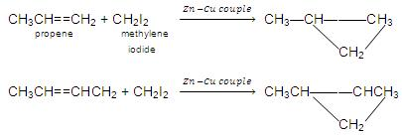
From alkenes : Alkenes on treating with CH₂I₂ in presence of Zn-Cu couple or by diazomethane (CH₂N₂) in presence of U.V. light gives derivatives of cycloalkanes.

Slide 47
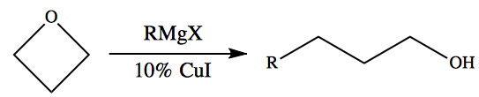

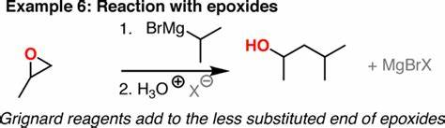
RING OPENING REACTIONS

Slide 48
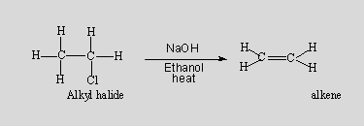
Eliminations reactions
An elimination reaction is a type of organic reaction in which two substituents are removed from a molecule in either a one or two-step mechanism. The one-step mechanism is known as the E2 reaction, and the two-step mechanism is known as the E1 reaction.
Elimination reaction is a type of reaction is mainly used to transform saturated compounds (organic compounds which contain single carbon-carbon bonds) to unsaturated compounds (compounds which feature double or triple carbon-carbon bonds).
For exp. Preparation of alkenes

Slide 49
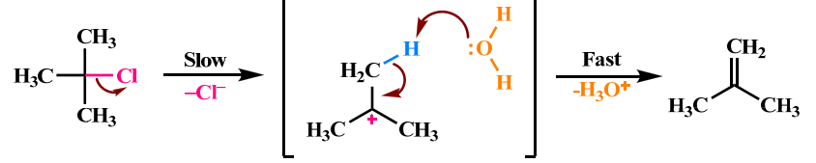
Types of Elimination Reactions
E1 Reactions (Unimolecuar eliminations)
It is a two-step process of elimination: ionization and deprotonation. Ionization: the carbon-halogen bond breaks to give a carbocation intermediate. Deprotonation of the carbocation.E1 typically takes place with tertiary alkyl halides, but is possible with some secondary alkyl halides.The reaction rate is influenced only by the concentration of the alkyl halide because carbocation formation is the slowest step, aka the rate-determining step. Therefore, first-order kinetics apply (unimolecular).
The reaction usually occurs in the complete absence of a base or the presence of only a weak base (acidic conditions and high temperature).

Slide 50
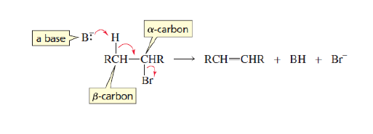
E2 Reactions (Bimolecular Reactions)
E2 stands for bimolecular elimination. The reaction involves a one-step mechanism in which carbon-hydrogen and carbon-halogen bonds break to form a double bond. E2 is single step elimination, with a single transition state.
It is typically undergone by primary substituted alkyl halides, but is possible with some secondary alkyl halides and other compounds.
The reaction rate is second order, because it's influenced by both the alkyl halide and the base (bimolecular).
E2 typically uses a strong base. It must be strong enough to remove a weakly acidic hydrogen.

Slide 51
Important Methods of Elimination Reaction
Normally, elimination reactions are distinguished by the kind of atoms or groups of atoms that leave the molecule. Due to this, there are two main methods involved in this type of reaction;
Dehydration
Dehydrohalogenation
In the dehydration method, there is the elimination of a water molecule mostly from compounds such as alcohol. Sometimes, this method is also called Beta elimination reaction where the leaving group and H are placed at neighbour carbon atoms.
On the other hand, in dehydrohalogenation, there is a removal of a hydrogen atom and a halogen atom.

Slide 52
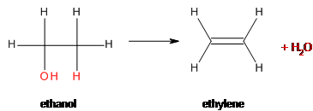
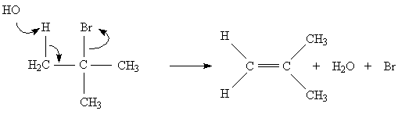
Dehydration
Dehydrohalogenation

Slide 53
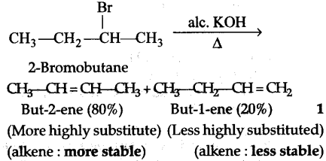
Saytzeff’s Rule
According to Saytzeff's rule (also Zaitsev's rule), during dehydration, more substituted alkene (olefin) is formed as a major product, since greater the substitution of double bond greater is the stability of alkene.
when 2-iodobutane is treated with alcoholic potassium hydroxide (KOH), 2-butene is the major product and 1-butene is the minor product.

Slide 54
Commonly used Drug Molecule
Drugs: Chemical substance used for the treatment of diseases and for reducing the suffering from pain are called medicines or drugs.
Based on their action these chemicals are divided into various categories :
1. Analgesics : Analgesics are compounds used to reduce pain.
2. Antipyretics : Antipyretics are compounds used to reduce fever.
One popular drug that does both is aspirins the common name for the compound acetylsalicylic acid, widely used as a fever reducer and as a pain killer.

Slide 55
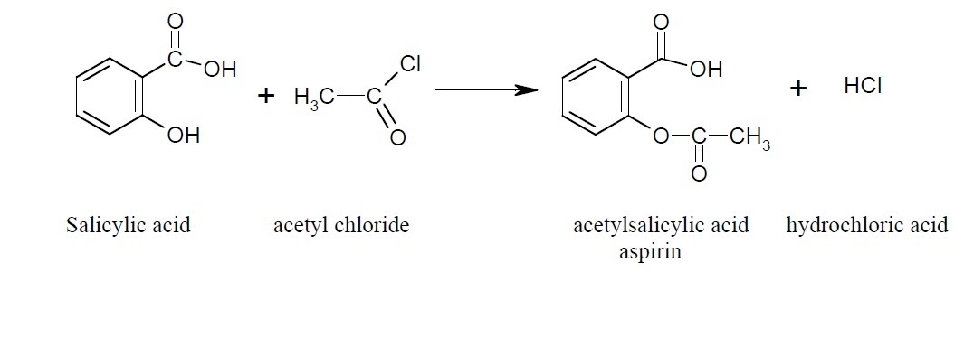
SYNTHESIS OF ASPIRIN (acetylsalicylic acid):
It is synthesized from salicylic acid and acetyl chloride in the presence of pyridine
The reaction involved is electrophilic substitution(Friedal craft acylation)

Slide 56
PROCEDURE
Place 2.0 g (0.015 mole) of salicylic acid in 4ml of dry pyridine a small conical flask.
Add 5 mL (0.05 mole) of acetyl chloride in the conical flask adding about 1ml of chloride at a time
Shake the content continuously during addition.
Heat the flask gently on the steam bath for at least 10 minutes.
Since the reaction nisexothermic , maintain the temperature between 50^{ᵒ}C and 60^{ᵒ}C throughout the addition, cool the flask occasional in cold water ,if necessary.

Slide 57
Allow the flask to cool to room temperature. If acetylsalicylic acid does not begin to crystallize out, scratch the walls of the flask with a glass rod. Cool the mixture slightly in an ice bath until crystallization is completed. The product will appear as a solid mass when crystallization is completed.
Add 50 mL of water and cool the mixture in an ice bath. Do not add the water until crystal formation is complete.
Vacuum filter the product using a Buchner funnel. You can use some of the filtrate to rinse the Erlenmeyer flask if necessary.
Rinse the crystals several times with small portions (5 mL) of cold water and air dry the crystals on a Buchner funnel by suction until the crystals appear to be free of solvent. Test this crude product for the presence of unreacted salicylic acid using the ferric chloride test. Record the weight of the crude solid which probably contains water.

Slide 58
Filter the solution through a Buchner funnel to remove any insoluble impurities or polymers that may have been formed. Wash the beaker and the funnel with 5 to 10 mL of water.
Carefully pour the filtrate with stirring, a small amount at a time, into an ice cold HCl solution (ca 3.5 mL of conc. HCl in 10 mL of water) in a 150-mL beaker and cool the mixture in an ice bath. Make sure that the resulting solution is acidic (blue litmus paper) and that the aspirin has completely precipitated out.
Cool the solution to room temperature and then in a ice-bath. Collect the product by vacuum filtration and rinse out of the flask with a few milliliters of cold petroleum ether.
When the product is completely dry, weigh its weight, determine its melting point (lit mp 135 °C) and calculate the percentage yield of this recrystallized product. Calculate the % recovery of recrystallized material from crude material.

Slide 59
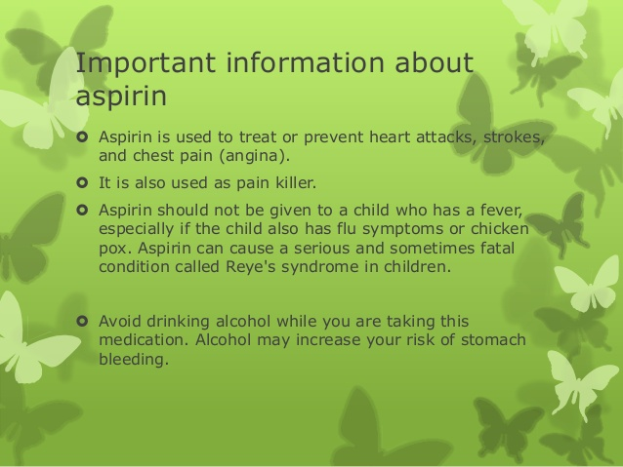

Slide 60
THANKS

